Slide 1
Topics
Arrays in Java

Slide 2
Arrays Introduction
Array → Collection of Homogeneous Data Elements
Arrays are objects and implements only static (fixed-length) arrays
Java follows strict bound checking for referencing array elements. If an attempt is made to reference the elements outside the bounds then “ArrayIndexOutOfBoundsException” will be thrown at run time.
Arrays can be 1-dimensional (1-D), 2-dimensional (2-D) or multidimensional.
Maximum Dimensions an Array can have = 255
Arrays are Objects in Java. So, every element at each index is automatically initialized to some default value depending upon the type of array. [byte, short, int and long → 0, float, double → 0.0, booelan → false, char → ‘’ (whitespace) and any class type array → null]
<<length>> is the attribute of each array which can be referenced by
<array-reference-name> . <length>

Slide 3
1-dimensional Arrays
Syntax : One-Dimensional Arrays :
type[ ] arrayname = new type[Size];
or
type arrayname[ ] = new type[Size];
Examples :
1. int[ ] marks = new int[10]; // Each element is initialized to 0
marks is an int type array, marks.length = 10, LB index =0 , UB index = 9
2. float[ ] values = new float[20]; // Each element is initialized to 0.0
values is an float type array, values.length = 20, LB index =0 , UB index =19
3. double cgpa[ ] = new double[5]; // Each element is initialized to 0.0
cgpa is double type array, cgpa.length = 5, LB index =0 , UB index = 4
4. Box[ ] boxes = new Box[20]; // Each element is initialized to ‘null’ value
boxes is a Box type array, boxes.length = 20, LB index =0 , UB index = 19
5. Point points[ ] = new Point[20]; // Each element is initialized to ‘null’ value
points is a Point type array, points.length = 20, LB index =0 , UB index =19
6. int[] marks = {10, 8, 6, 34, 0, 34};
marks is a int type array, marks.length = 6, LB index = 0, UB index = 5

Slide 4
2-dimensional Arrays
Syntax : Two-Dimensional Arrays :
type[ ][ ] arrayname = new type[Row_Size][Col_Size];
or
type arrayname[ ][ ] = new type[Row_Size][Col_Size];
Row index varies from 0 to Row_Size – 1
Column index varies from 0 to Col_Size – 1
Examples :
1. int[ ][ ] data = new int[3][3]; // Each element is initialized to 0
data is 2-D int array, capacity = 9, row index 0 to 2 col index 0 to 2
2. float values[][] = new float[10][4]; // Each element is initialized to 0.0
values is 2-D float array, capacity = 40, row index 0 to 9 col index 0 to 3
3. int table[][] = {{ 0,0,0},{1,1,1}}; // initializes first row to 0 & second to 1

Slide 5
2-dimensional Arrays ….
Java treats a 2-D array as a collection of 1-D arrays.
In two-dimensional arrays, individual rows can have variable number of elements <Variable Size Array>
Example
int[][] data = new int[4][]; // Variable-Size Array, column-size not mentioned
data is a 2-D array having 4 rows (row-index varies from 0 to 3)
data[0] = new int[10]; // Row-0 has 10 elements, column-index varies from 0 to 9
data[1] = new int[5]; // Row-1 has 5 elements, column-index varies from 0 to 4
data[2] = new int[6]; // Row-2 has 6 elements, column-index varies from 0 to 5
data[3] = new int[10]; // Row-3 has 10 elements, column-index varies from 0 to 9
data[1][6] → Results in ArrayIndexOutofBounds Exception
data[2][6] → Results in ArrayIndexOutofBounds Exception

Slide 6
Referring Array Elements
1-D Arrays, Syntax → array-name[<index>], where <index> varies from 0 (LB) to array-name.length-1(UB)
2-D Arrays, Syntax → array-name[<row-index>][<col-index], where <row-index> varies from 0 to no-of-rows -1, and <col-index> varies from 0 to no-of-cols -1.
Example
int[] data = new int[5] ; data[0] = 0; ….., data[4] = 0;
boolean[] flags = new boolean[10]; flag[0] = false, ….., flags[9] = false
String[] names = new String[5]; names[0]=null, …..., names[4] = null
double[] values = {10.5, 5.6, 7.5, 4.5};
values[0] = 10.5, values[1] = 5.6, values[2] = 7.5, values[3] = 4.5
int [][] marks = {{10,40,20},{25,56,57},{10,89,94}}
marks[0][0] = 10, marks[0][1] = 40, marks[0][2] = 20,
marks[1][0] = 25, marks[1][1] = 56, marks[1][2] = 57,
marks[2][0] = 10, marks[2][1] = 89, marks[2][2] = 94

Slide 7
Displaying 1-D Array Elements
Two Methods
Method 1: Using for { .. } loop
Example :
int data[] = {10,6,8,9,-4,5};
for(int i=0; i<data.length; i++)
System.out.println(data[i]);
Method 2: Using for each loop
Syntax : for(<type-of-array> <variable> : <array-name>)
Variable is automatically considered as of ‘int’ type The same variable is to be used inside the loop
Example :
int data[] = {10,6,8,9,-4,5};
for(int i : data)
System.out.println(i);

Slide 8
Displaying 1-D Array Elements : Example 1
// File Name : Demo.java
class Demo
{
public static void main(String[] args)
{
boolean[] flags = new boolean[5];
// Method-1 : Using for loop
System.out.println(“Output by Method 1”);
for(int i =0; i < flags.length; i++)
System.out.println(flags[i]);
// Method-2 : Using for each loop
System.out.println(“Output by Method 2”);
for(boolean k : flags)
System.out.println(k);
}// End of Method
}// End of class Demo
<<OUTPUT>>
Output by Method 1
false
false
false
false
false
Output by Method 2
false
false
false
false
false

Slide 9
Displaying 1-D Array Elements : Example 2
// File Name : Demo.java
class Demo
{
public static void main(String[] args)
{
String[] names = new String[5];
// Method-1 : Using for loop
System.out.println("Output by Method 1");
for(int i =0; i < names.length; i++)
System.out.println(names[i]);
// Method-2 : Using for each loop
System.out.println("Output by Method 2");
for(String k : names)
System.out.println(k);
}// End of Method
}// End of class Demo
F:\>java Demo
Output by Method 1
null
null
null
null
null
Output by Method 2
null
null
null
null
null

Slide 10
Displaying 2-D Array Elements
Two Methods
Method 1: Using nested for { .. } loop
Example :
int data[][] = new int[5][5];
System.out.println(data.length); // Displays 5 not 25
for(int i=0; i<data.length; i++) // data.length = no of rows
for(int j=0; j<data[i].length; j++) // each jth column under ith row
System.out.println(data[i][j]);
Method 2: Using nested for each loop
Syntax : for(<type-of-array> [ ] <variable-i> : <array-name>)
for(<type-of-array> <variable-j> : <variable-i>

Slide 11
Displaying 2-D Array Elements : Example
// File Name : Demo.java
class Demo
{
public static void main(String[] args)
{
int[][] data = new int[5][5];
System.out.println(data.length); // Displays 5
// Method 1
System.out.println("Method 1 : Using Nested for Loop");
for(int i = 0; i < data.length; i++)
for(int j = 0; j < data[i].length; j++)
System.out.println(data[i][j]);
// Method 2
System.out.println("Method 2 : Using Nested for-each Loop");
for(int[] i : data)
for(int j : i)
System.out.println(j);
}// End of Method
}// End of class Demo

Slide 12
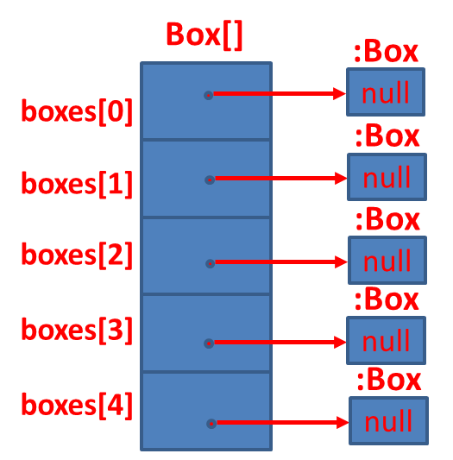
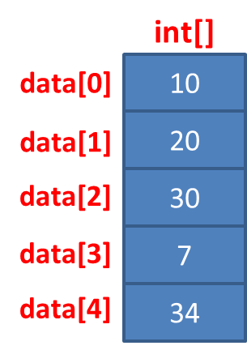
Primitive Type vs Object Type Array
int[] data = { 10, 20, 30, 7, 34 };
Box[] boxes = new Box[5];
String[] names = { “David”, “Ram”, “Mike”};
String[]
:String
names[0]
David
:String
names[1]
Ram
:String
names[2]
Mike

Slide 13
Thank You

